Slide 1
Sitting in meetings all day long
My first 180 days as a new Software Engineering Manager
Dennis Dietrich Manager Software Development ICS, Phoenix Contact
Rev. 1 (2024-05-??), https://github.com/dennisdietrich/First180Days/
Notes:
YMWV – Your Mileage Will Vary

Slide 2
Overview
Getting ready
Leadership and management
Lessons in communication
Tactical and strategic staffing
Dealing with ”large" amounts
Reaching the next level

Slide 3
Getting ready

Slide 4
Getting ready Being a (tech) lead

Slide 5
Getting ready Taking courses

Slide 6
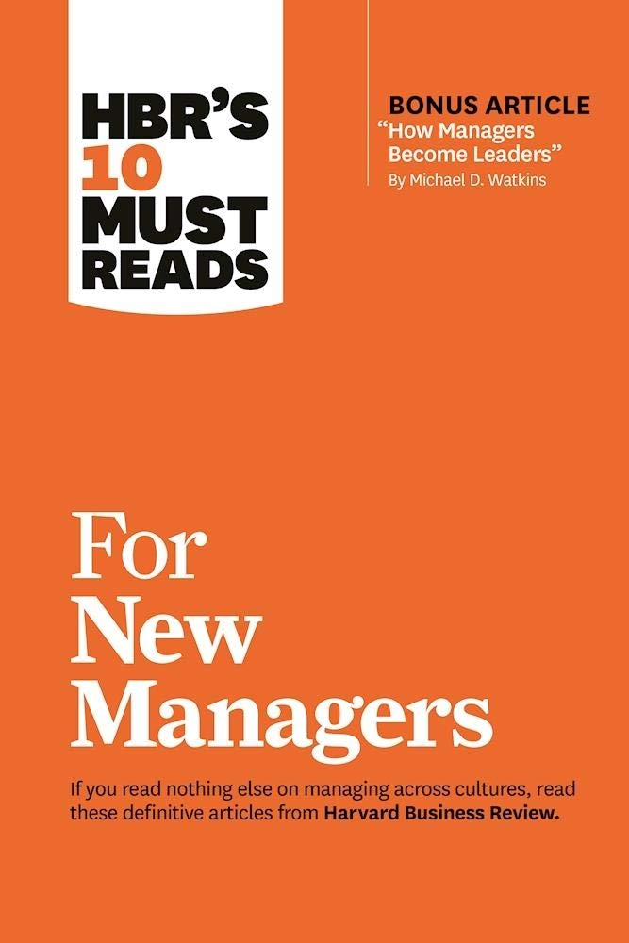

Getting ready Books and magazines I
HBR's 10 Must Reads for New Managers
Harvard Business Review Press
978-1633693029
The Manager's Path
Camille Fournier
O'Reilly Media
978-1491973899
Notes:
HBR's 10 Must Reads for New Managers (https://store.hbr.org/product/hbr-s-10-must-reads-for-new-managers-with-bonus-article-how-managers-become-leaders-by-michael-d-watkins/10134)
The Manager's Path (https://www.oreilly.com/library/view/the-managers-path/9781491973882/)

Slide 7


Getting ready Books and magazines II
Harvard Business Review
Harvard Business Publishing
0017-8012
The Culture Map
Erin Meyer
PublicAffairs
978-1610392761
Notes:
The Culture Map (https://erinmeyer.com/books/the-culture-map/)

Slide 8
Getting ready Looking back

Slide 9
Leadership and management

Slide 10
Leadership and management An Outlook on helping Teams Excel

Slide 11
Leadership and management Definitions

Slide 12
Leadership and management Informal leadership

Slide 13
Leadership and management Management styles

Slide 14
Leadership and management About fine print

Slide 15
Leadership and management Performance management

Slide 16
Leadership and management Leaving your comfort zone
Defining and improving processes
Producing new roles
Staffing reductions

Slide 17
Lessons in communication

Slide 18
Lessons in communication Reading between the lines

Slide 19
Lessons in communication They’ll listen… to something

Slide 20
Lessons in communication "Managing" in all sorts of directions
Managing up
Managing laterally

Slide 21
Tactical and strategic staffing

Slide 22
Tactical and strategic staffing Tactical (short-term)

Slide 23
Tactical and strategic staffing Strategic (long-term)
Don’t assume what people are interested in

Slide 24
Dealing with "large" amounts

Slide 25
Dealing with "large" amounts From retail to buying in bulk…

Slide 26
Dealing with "large" amounts …to labor costs

Slide 27
Reaching the next level

Slide 28
Reaching the next level …of what?

Slide 29
Reaching the next level More reading and courses!

Slide 30
Reaching the next level Formal education

Slide 31



Questions?
dennisdietrich
dcdietrich
@dc@social.advancedsoftware.engineering

Slide 32
Thanks for listening!
dennisdietrich
dcdietrich
@dc@social.advancedsoftware.engineering

